Slide 1
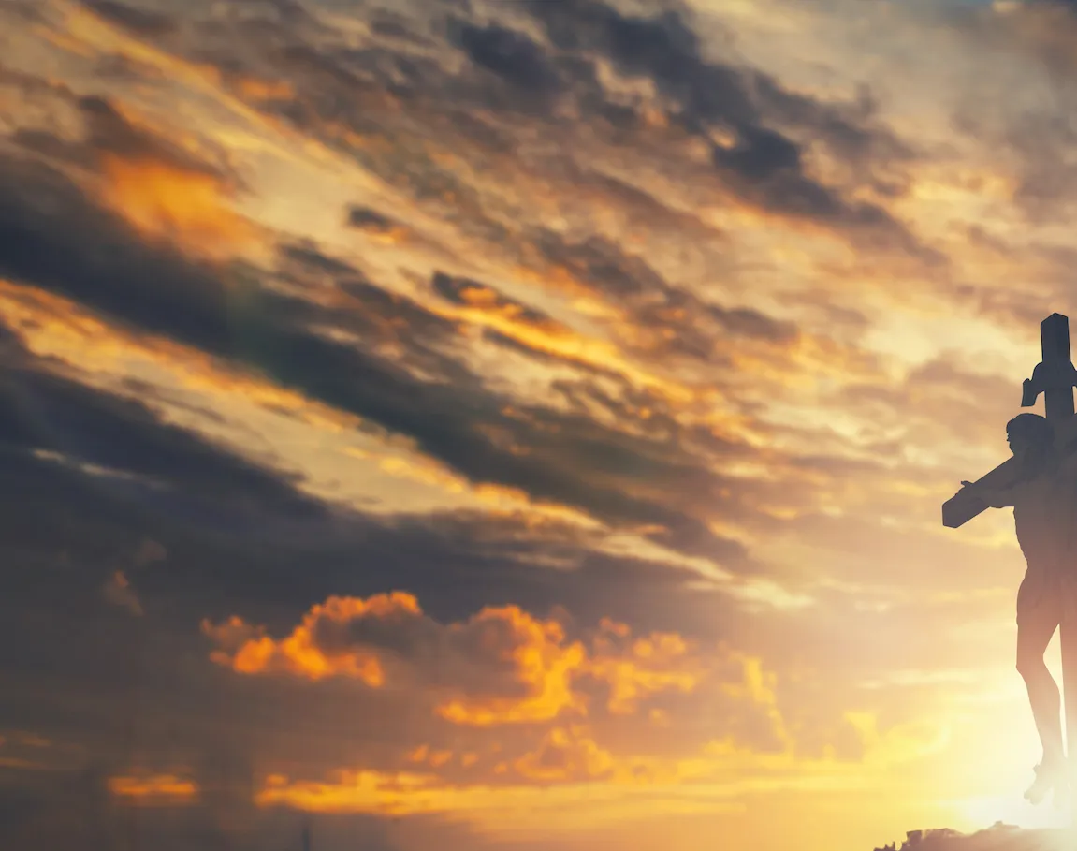
Only A Holy God

Slide 2
Am / C / F / C CAPO 2nd for Marina, Skyler
Am C F C
Who else commands all the hosts of heaven
Am C F C
Who else could make every king bow down
Am C F C
Who else can whisper and darkness trembles
F G C
Only a Holy God

Slide 3
Am C F C
What other beauty demands such praises
Am C F C
What other splendour outshines the sun
Am C F C
What other majesty rules with justice
F G C
Only a Holy God

Slide 4
Am F
Come and behold Him
C G
The One and the Only
Am F
Cry out, sing holy
C G Am
Forever a Holy God
F G
Come and worship the Holy God

Slide 5
Am C F C
What other glory consumes like fire
Am C F C
What other power can raise the dead
Am C F C
What other name remains undefeated
F G C
Only a Holy God

Slide 6
Am F
Come and behold Him
C G
The One and the Only
Am F
Cry out, sing holy
C G Am
Forever a Holy God
F G
Come and worship the Holy God
x2

Slide 7
Am C F C
Who else could rescue me from my failing
Am C F C
Who else would offer His only Son
Am C F C
Who else invites me to call Him Father
F G C
Only a Holy God

Slide 8
Am F
Come and behold Him
C G
The One and the Only
Am F
Cry out, sing holy
C G Am
Forever a Holy God
F G
Come and worship the Holy God
END

